Slide 1


Up & Running
Vue.js Oslo meetup#1
25th, Jan 2018
Majid Hajian

Slide 2

ABOUT ME
Passionate web developer
Open Source lover and contributor
Public speaker, Organizer
PacktPub Instructor
Majid Hajian
@mhadaily

Slide 3

My Hope Today…

Slide 4
Content Overview
Up & Running
VUE HISTORY
FUNDAMENTALS
COMPONENTS & ROUTER
VUE CLI
IDEAs & EDITORs
DEV TOOLS
STATE MANAGERMENT
UNIT & E2E TESTING
PWA & SSR

Slide 5

VUE
HISTORY
Vue (pronounced /vjuː/, like view) is a progressive framework for building user interfaces. Unlike other monolithic frameworks, Vue is designed from the ground up to be incrementally adoptable. The core library is focused on the view layer only, and is easy to pick up and integrate with other libraries or existing projects. On the other hand, Vue is also perfectly capable of powering sophisticated Single-Page Applications when used in combination with modern tooling and supporting libraries.

Slide 6



EVAN YOU
Creator
V0.6.0, FEB 2014
April 2015
FIRST RELEASE
USED BY LARAVEL
STARTED
V1.0.0
VERSION 2
Last 2013, First Commit
OCTOBER 2015
SEP 2016

Slide 7

Vue
Fundamentals
The official guide assumes intermediate level knowledge of HTML, CSS, and JavaScript. If you are totally new to frontend development, it might not be the best idea to jump right into a framework as your first step - grasp the basics then come back! Prior experience with other frameworks helps, but is not required.

Slide 8
5 Steps to Start
EASY!
01
Declarative Rendering
02
Directives
03
Computed Properties
04
Methods
05
Filters

Slide 9
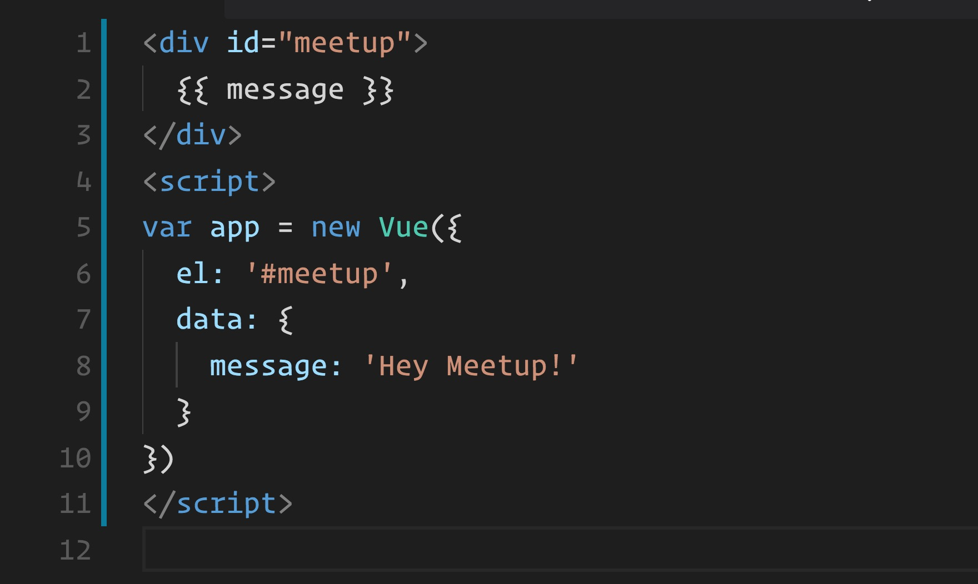
RENDERING
1- CDN: https://cdn.jsdelivr.net/npm/vue
2- NPM: ` npm install vue `
3- CLI: …

Slide 10
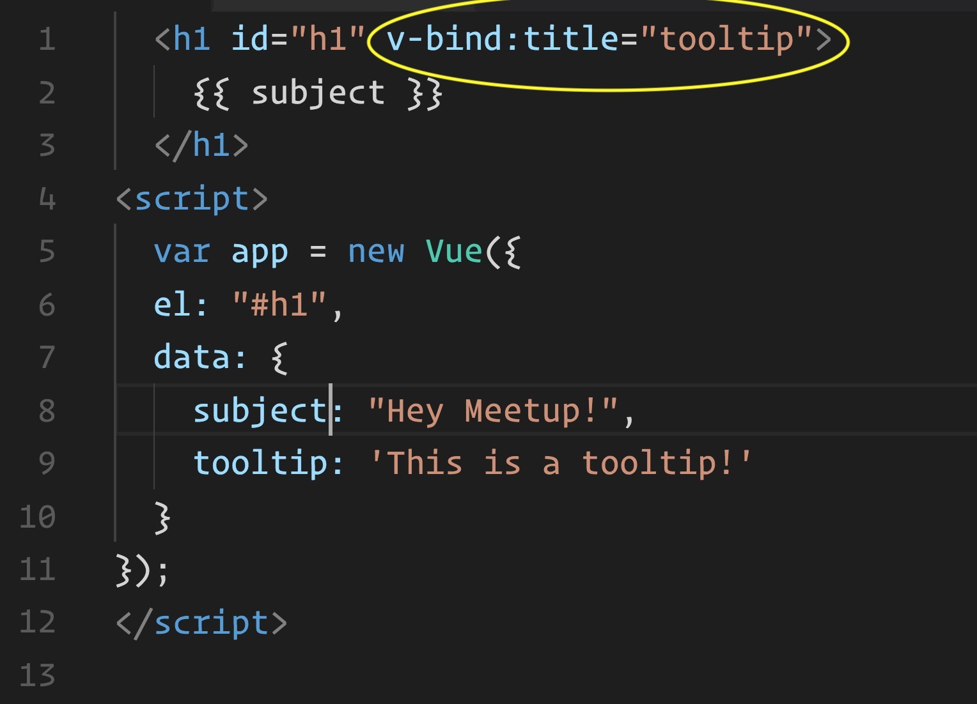
DIRECTIVEs
v-text
v-html
v-show
v-if
v-else
v-else-if
custom
v-for
v-on
v-bind
v-model
v-pre
v-cloak
v-once

Slide 11
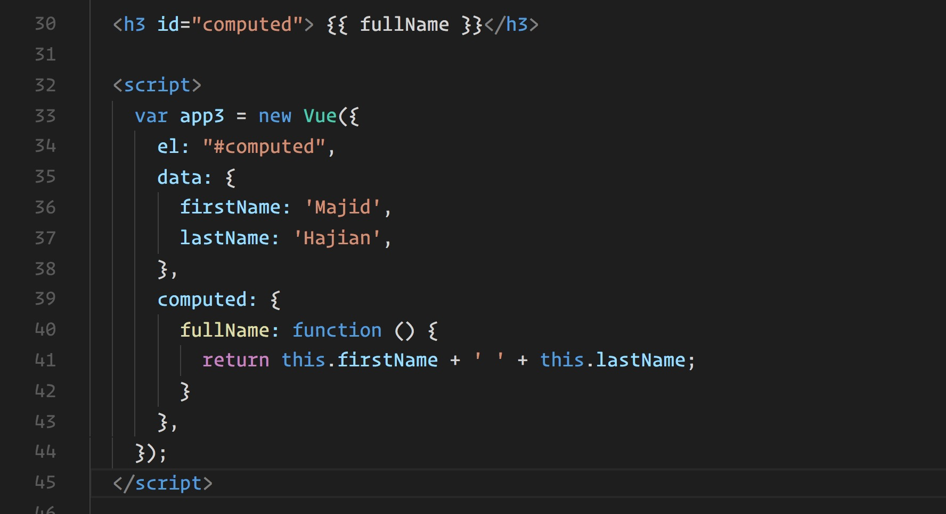
COMPUTED
PROPERTY
Computed properties to be mixed into the Vue instance. All getters and setters have their this context automatically bound to the Vue instance.
* DON’T USE
ARROW FUNCTIONS

Slide 12
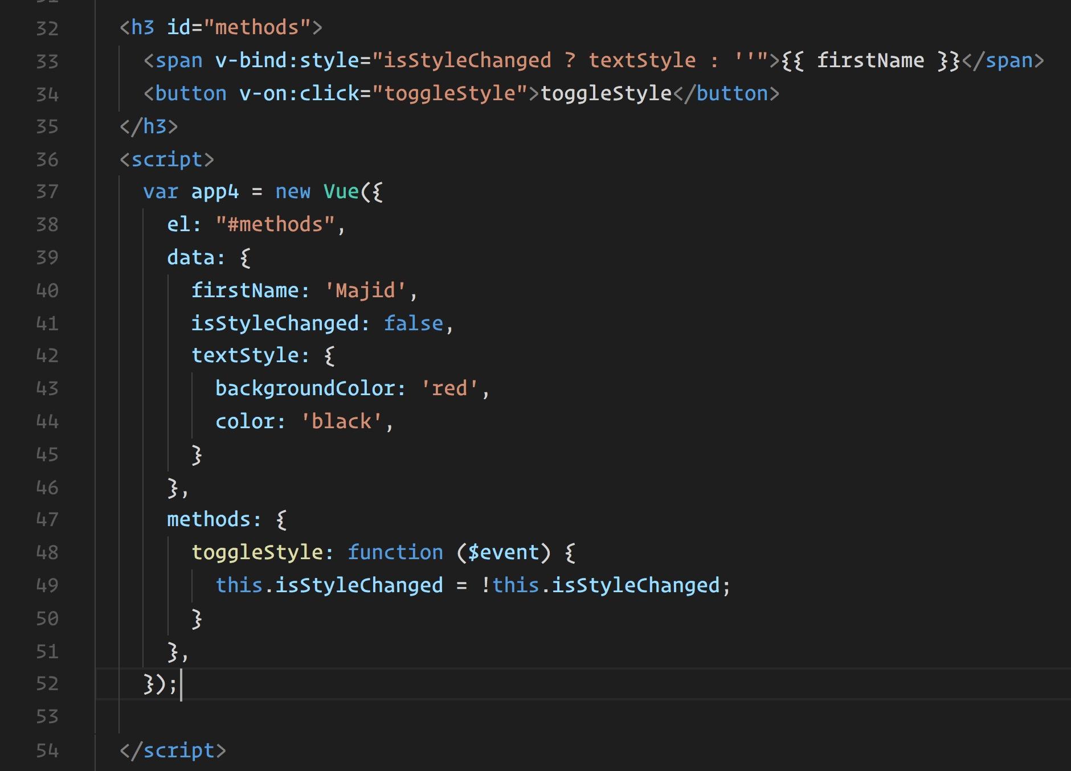
METHODS
Methods to be mixed into the Vue instance. You can access these methods directly on the VM instance, or use them in directive expressions. All methods will have their this context automatically bound to the Vue instance.

Slide 13
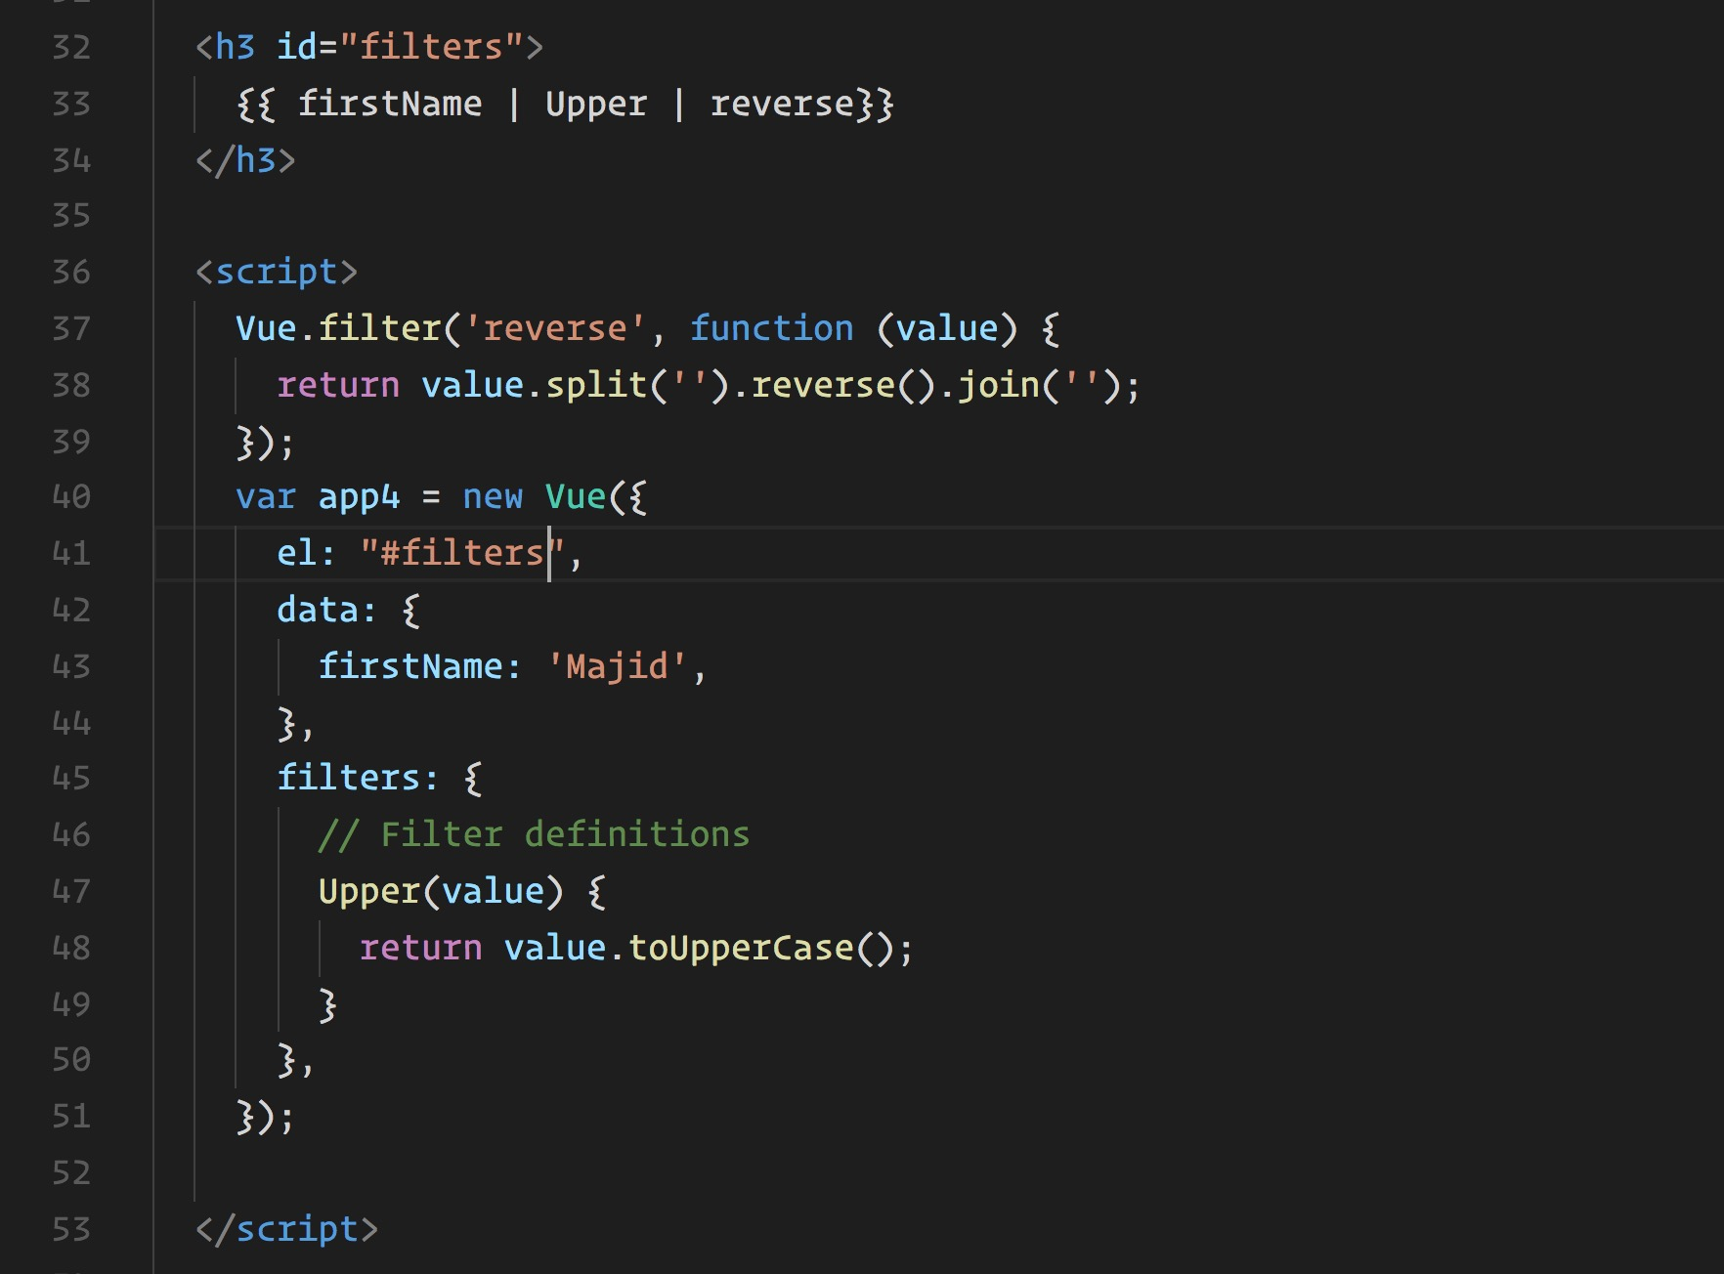
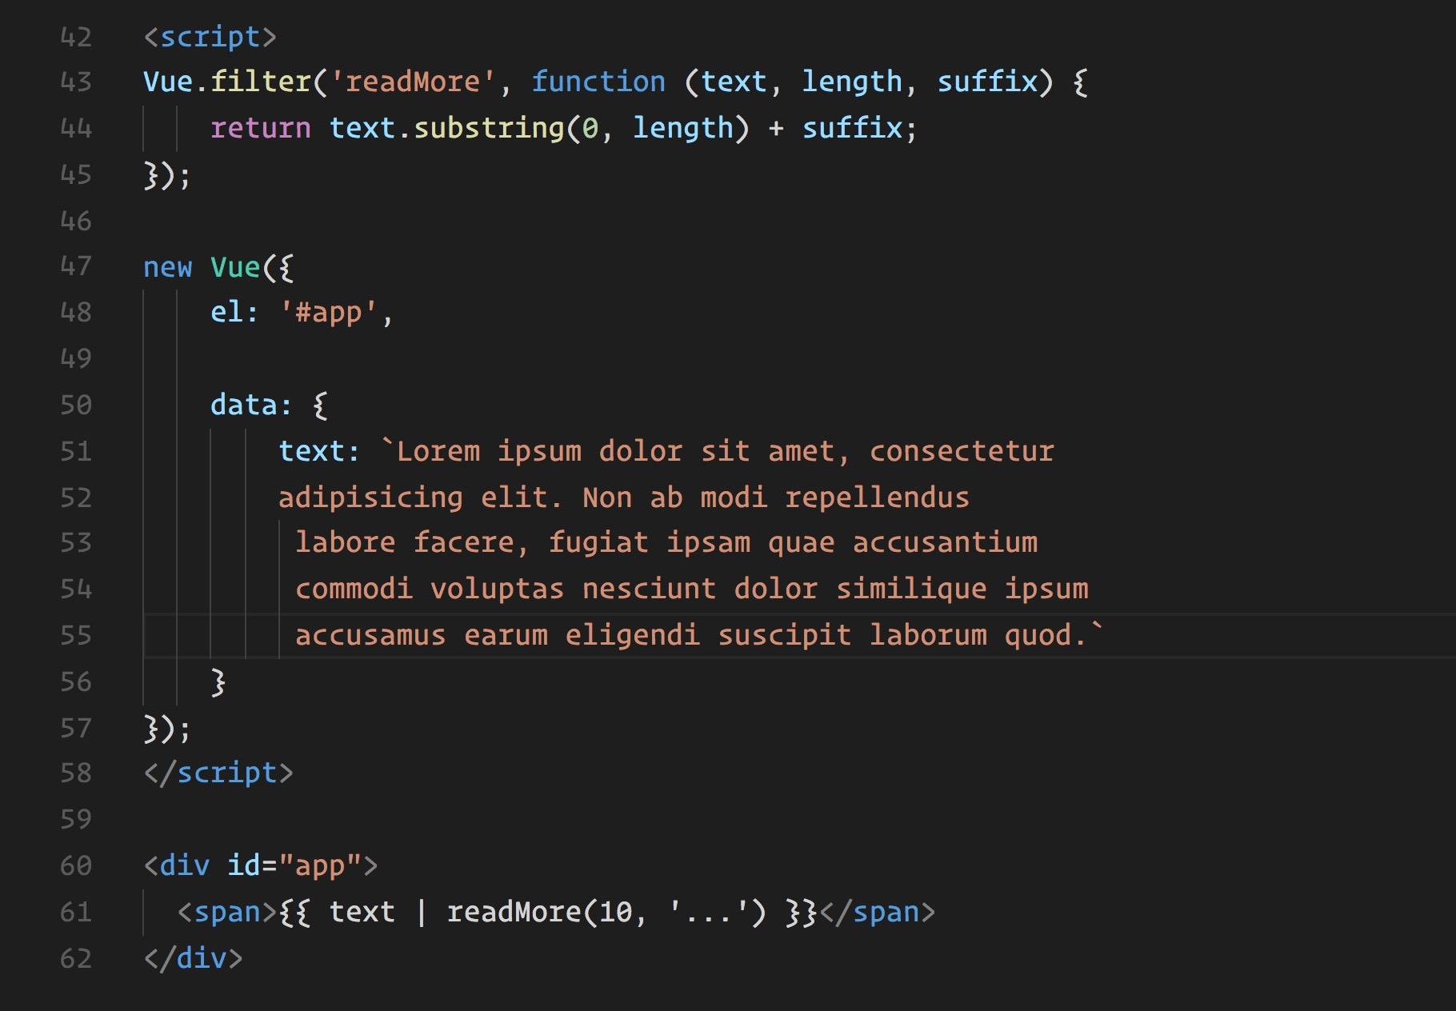
Filters
1- Locally
2- Globally
Filter with argument

Slide 14
SHOW ME PLEASE
DEMO TIME

Slide 15

TIME
TO SCALE UP

Slide 16


VUE
COMPONENT
And Router

Slide 17
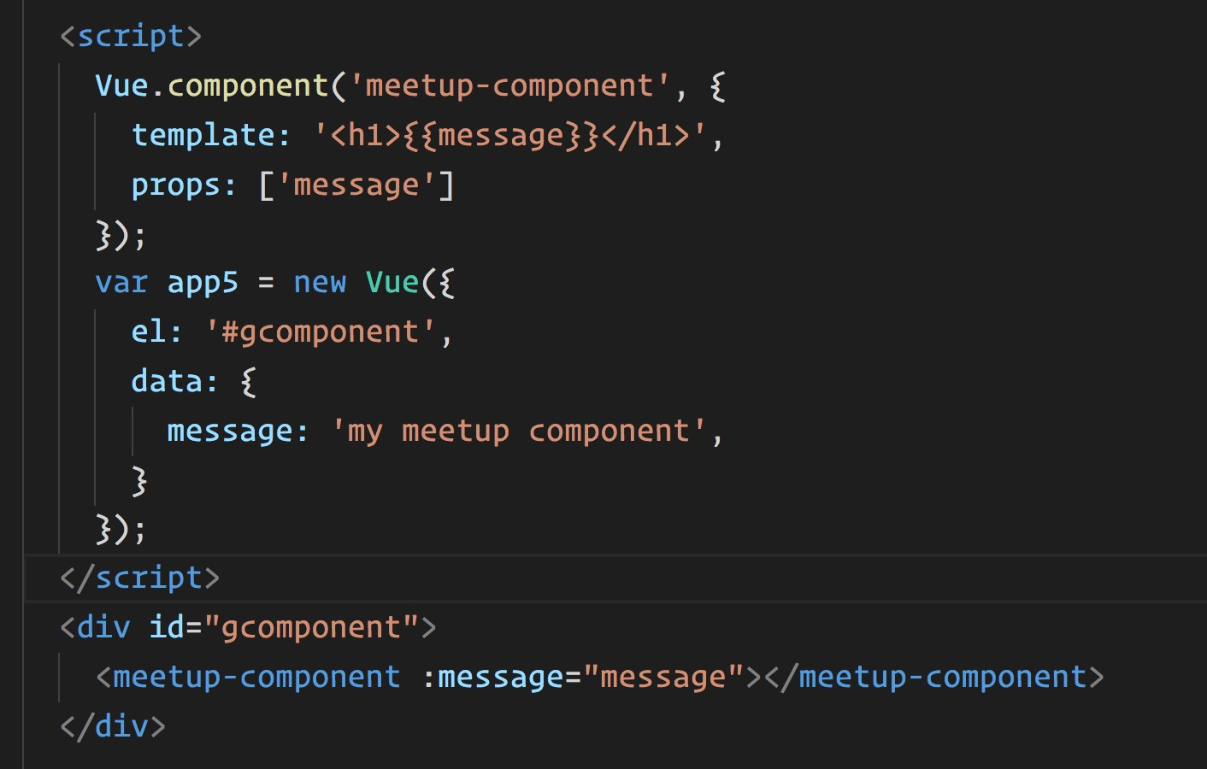
VUE COMPONENTs
Best of the best
01
02
Powerful
Reusable
03
04
Encapsulate
Register Globaly / Local

Slide 18
String
Template literal
X-Templates
Inline
Render functions
JSX
Single page components
7 Ways to Define
Component Templates

Slide 19
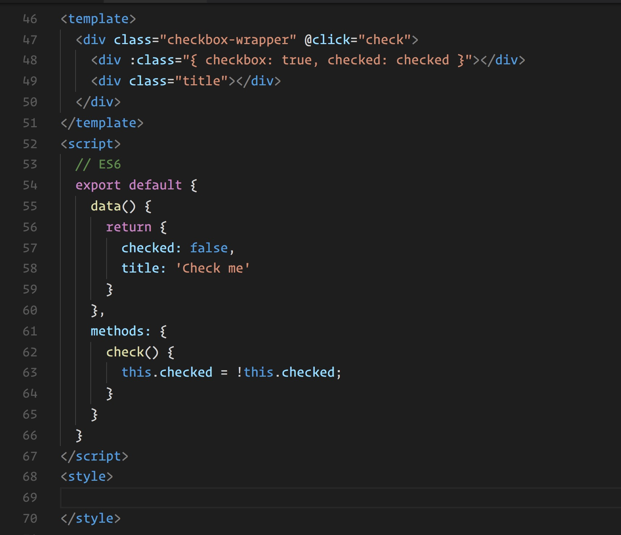
SINGLE
COMPONENT
component.vue

Slide 20

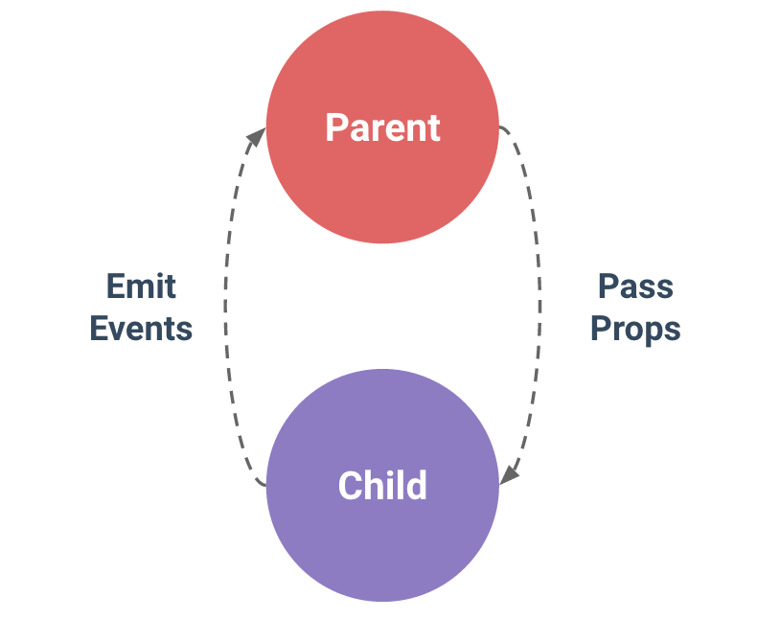

VS
DUMB
SMART

Slide 21
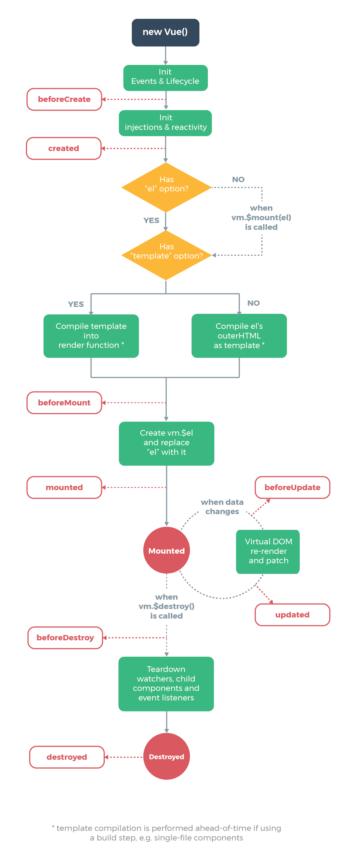
Lifecycle hooks are an important part of any serious component. You often need to know when your component is created, added to the DOM, updated, or destroyed. Lifecycle hooks are a window into how the library you’re using works behind-the-scenes, and as such tend to invoke feelings of trepidation or unease for newcomers.
DEMO AFTER CLI

Slide 22

VUE
CLI
Easy and hassle free way to scale up

Slide 23
Using vue-cli for quick project scaffolding
Because it’s awesome!
Build out of the box
Webpack and zero configuration
Browserify if you like!
Hot Reload & Vue-loader
ES2015, single-file component with hot reloading and custom CSS preprocessors
Linting & Testing
Be consistent
Make sure everything is working!
Official Templates
Webpack, webpack-simple, browserify , browserify-simple, pwa, simple

Slide 24
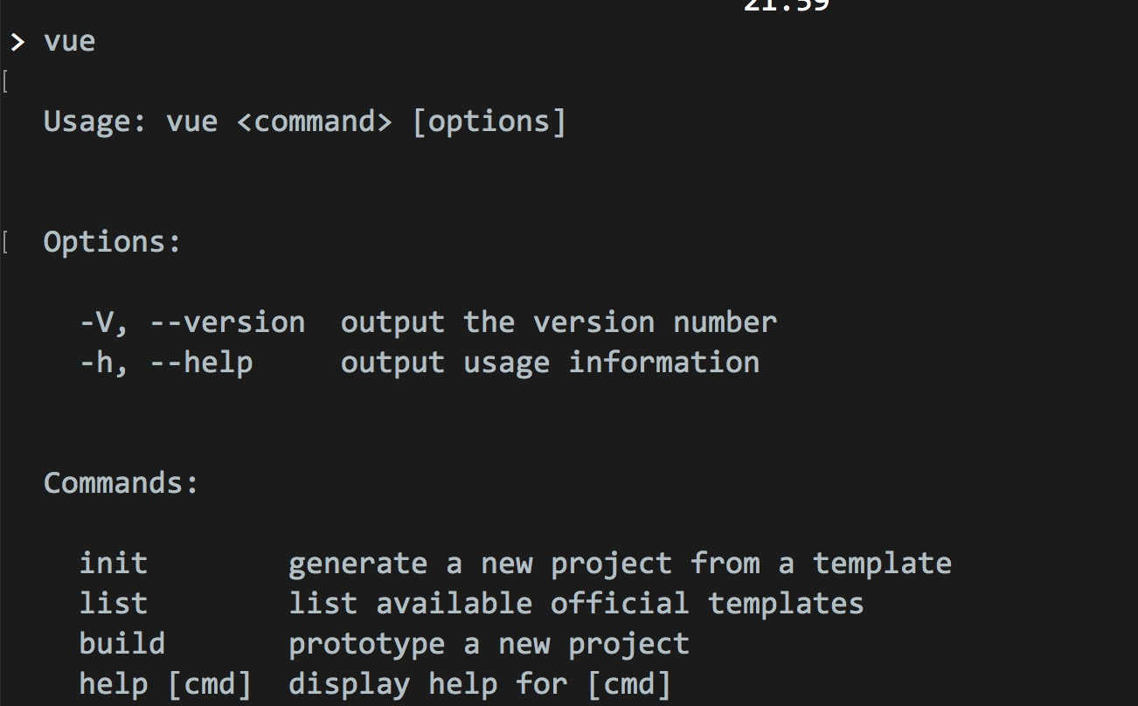
INSTALLATION
Easy!
npm install -g vue-cli
vue init <template-name> <project-name>
vue init webpack vue-meetup

Slide 25
SHOW ME PLEASE
DEMO TIME

Slide 26

IDEAs & EDITORs
DEV TOOLS

Slide 27
SHOW ME PLEASE
DEMO TIME

Slide 28
STATE MANAGERMENT

Slide 29
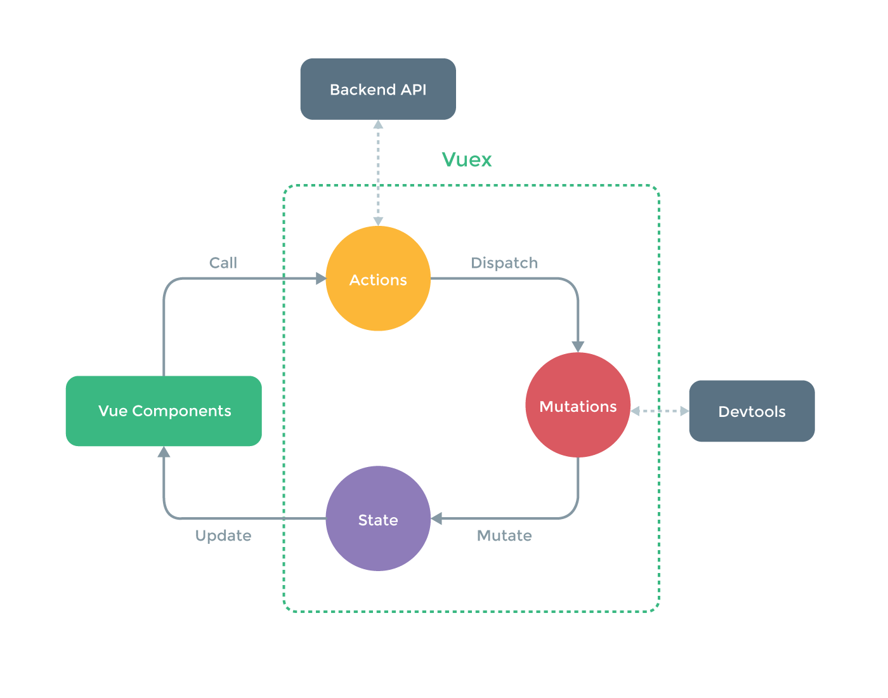

Slide 30
SHOW ME PLEASE
DEMO TIME

Slide 31

UNIT & E2E TESTING

Slide 32
SHOW ME PLEASE
DEMO TIME

Slide 33

PWA
&
SERVER SIDE RENDERING
&
NATIVE APPs

Slide 34

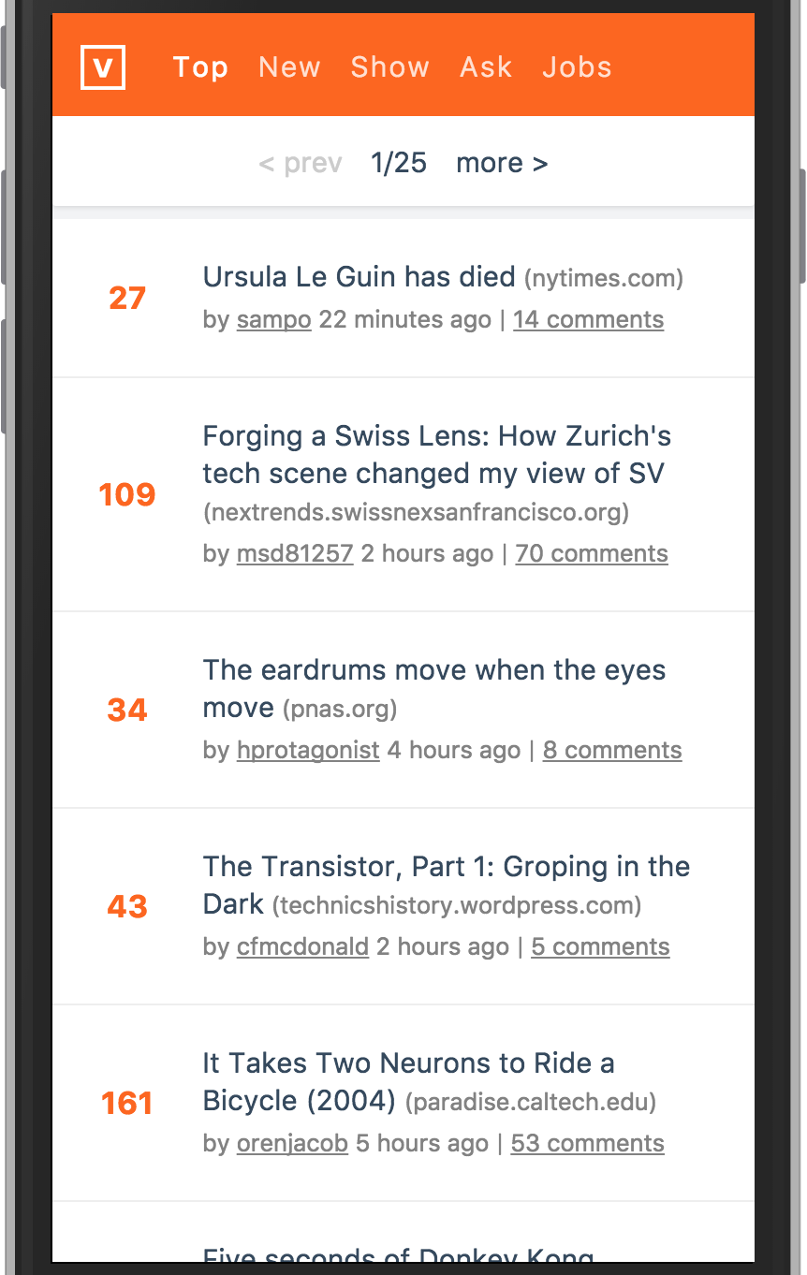
PWA
* VUE-CLI TEMPLATE
* WORKBOX

Slide 35

SSR
Server side rendering
01
VUE.js SSR
A server-rendered Vue.js app can also be considered "isomorphic" or "universal", in the sense that the majority of your app's code runs on both the server and the client.
02
NUXT.js
Nuxt.js is really easy to get started with. A simple project only needs the nuxt dependency.
03
Prerendering
Rather than using a web server to compile HTML on-the-fly, prerendering simply generates static HTML files for specific routes at build time. The advantage is setting up prerendering is much simpler and allows you to keep your frontend as a fully static site.
prerender-spa-plugin.

Slide 36
NATIVE APPS
* NativeScript
* WEEX

Slide 37
THANK YOU
See You Next Time
MAJID HAJIAN
@mhadaily

